Slide 1
Adult Income Analysis and Model
GROUP

Slide 2
Objectives
Analyze adult income data to understand what factors affect income and how.
Check whether feature engineering could improve model performance.
Predict whether an individual earns >50k or <=50k

Slide 3
Understanding Dataset
The dataset was extracted from 1994 census database and authored by Ronny Kohavi and Barry Becker.
Contains 32561 records with 15 features.
Raw data showed no missing values but ‘?’ was present in some columns, it was replaced with NA.

Slide 4
Descriptive summary
Mean age was 38.58, with the oldest person aged 90 years and youngest 17.
Maximum capital loss for the sample was 4356, least capital loss was 0 and mean loss was 87.30.
Half of the sample size work on average 40 hours per week, 25% working 45 hours per week.

Slide 5
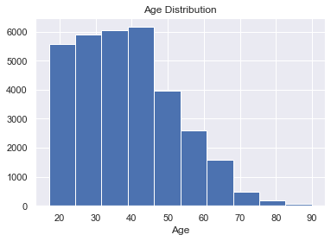
Age Distribution
Age is skewed to the left with large proportion in 30-45 age bracket.

Slide 6
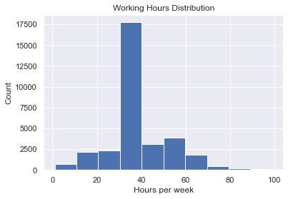
Work Hours per week
Largest proportion from the sample work 40 hours per week. Followed by those working 60 hours per week.

Slide 7
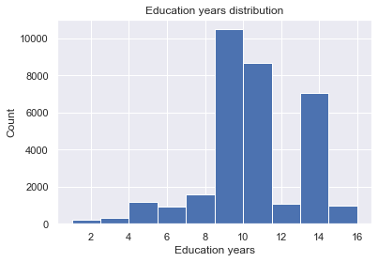
Education Years
Largest proportion spent 10-12 years on education, that is either high school grad to college or a bachelors degree level.

Slide 8
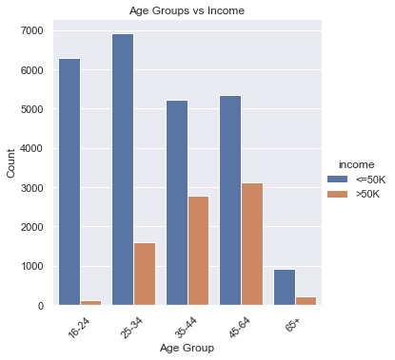
Age Groups v.s Income
Large proportion in 16-24 age bracket earn <=50k.
The number of people earning >50k increases with age and shows a declining trend after 65 years.
Age was a good predictor for income.

Slide 9
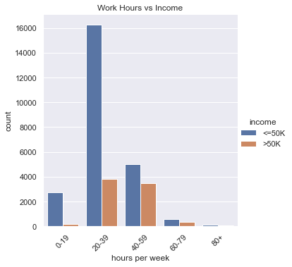
Work hours v.s Income
As the number of working hours increases the gap between those earning >50 and less decreases. This implies work hours affect income.
40-59 hours had highest correlation of 0.40 to income followed by 60-79 hours at 0.37.

Slide 10
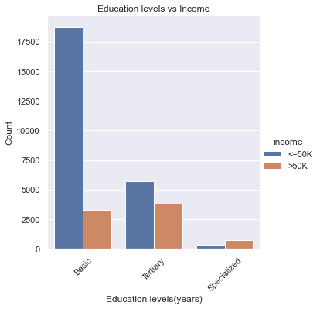
Education Level v.s Income
Grouping education years:
Basic= 1-9 years
Tertiary 10-12 years
Specialized 13-16 years
Large proportion with basic level education earn <=50k
Largest proportion in specialized level earn >50k

Slide 11
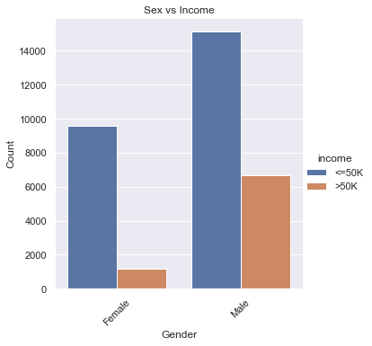
Sex v.s Income
In the female category few earn >50.
Male had highest positive correlation(0.3) to earning >50k compared to their counterparts.

Slide 12
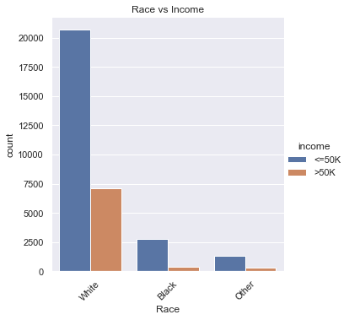
Race v.s Income
White and Black races contributed large proportions to data, the remaining categories were mapped to Other.
White had high correlation of 0.25 while Black had the least positive correlation 0.12.

Slide 13
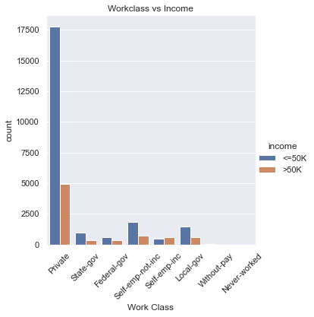
Workclass v.s Income
It is evident there is a strong relationship between workclass and income. Self-employed-inc people had highest chance earning >50k with correlation >0.5.
Workclass was a good predictor for our model.

Slide 14
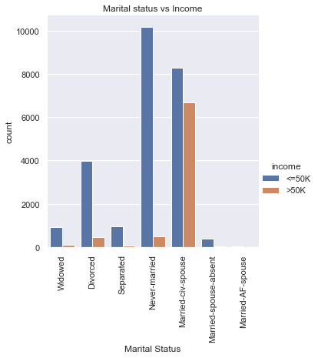
Marital Status v.s Income
Never-married individuals had low chance earning >50k, while married-civ-spouse had highest chance earning >50k.
This was an important variable to our goal.

Slide 15
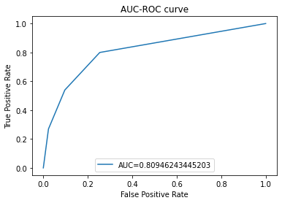
K-Nearest Neighbor Model
Two evaluation metrics were applied on the final model. The model achieved 81% training accuracy score and 81.4% on unseen data.
The AUC metric was used to measure model performance on unseen data as well. This value should range from 0-1, the higher the value the better the model. Our model did a good job predicting classes in target variable.

Slide 16
Conclusions
Converting continuous variables into categorical made work easier computing correlations and visualizing patterns.
Label encoding for nominal categorical variables introduce bias in data, therefore one-hot-encoding is recommended for nominal categories as it eliminates bias and improves model performance.
Feature engineering improved model performance compared to K-nearest models trained on all the original variables.
Cross validation is an important technique when selecting optimal value of k-neighbors, this ensures final model does not over-fit or under-fit data.
Accuracy score should be used with other metrics like AUC to evaluate model performance.

